Slide 1
Understanding in Design
Dr Terence Love
Presented as part of LINUS PAULING MEMORIAL LECTURE Jan 2009
Institute of Science, Engineering and Public Policy , Portland, Oregon

Slide 2
Emotion
Sensing system
for environment
Organism

Slide 3
Emotion
Sensing system
for environment
Sensing system (inside organism)
Movement system
Organism
Digestion system
Reproduction system

Slide 4
Emotion & UnderstanDing
Sensing system
for environment
Sensing system (inside organism)
Movement system
Organism
Digestion system
Reproduction system
No brain needed for basic understanding!
Processes that connect systems and result in survival, continuity, learning & development

Slide 5
Emotion Behaviour
Move away from? Attack? Eat? Mate with? Have fun with?
Organism A
Organism B

Slide 6
Emotion Behaviour
Move away from? Attack? Eat? Mate with? Have fun with?
Changes inside A
Organism A
Changes inside B
Organism B
The changes are emotions

Slide 7
Damasio - Emotion
Emotion – body changes from perception of an object
Internal milieu - endocrine system
Visceral– blood flow, skin, gut etc
Musculoskeletal - muscle tone, posture, facial appearance etc
Animals also show emotions

Slide 8
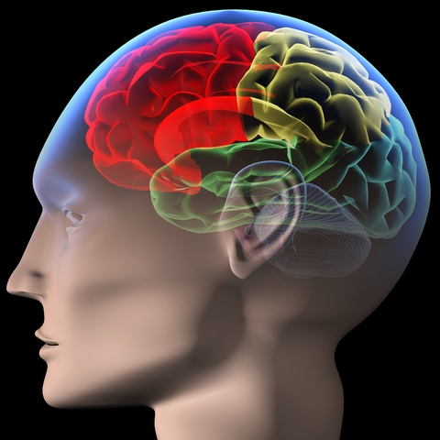
Damasio – FEELING AN EMOTION
Feeling of an emotion
Neurological image representing
the emotion
Feeling an emotion is usually unconscious.
Different from the physicality of the emotion

Slide 9
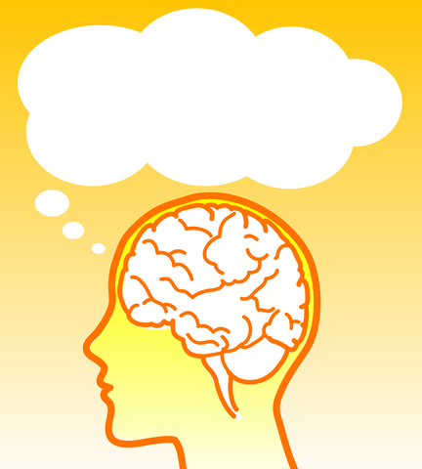
Damasio - SELF FEELING AN EMOTION
Sense of self feeling an emotion (usually conscious)
I feel HAPPY!
Different from feeling an emotion.
Different from the emotion itself.

Slide 10
Self and consciousness
Damasio distinguishes:
Proto-self
Core –consciousness
Extended (autobiographical) consciousness

Slide 11
Proto-self
A neurological image of all aspects of the body at a moment in time. This is homeostatic and unconscious.
Neurological image representing
all aspects of the state of body

Slide 12
Perceiving an object
Image representing changes in the perceivers body due to perceiving an object

Slide 13
Core consciousness
Core Consciousness is the process underpinning an individual’s ‘sense of self’.
It comprises a neurological 2nd order neural image representing the moment by moment differences between the proto-self and body and neural changes due to perceiving an object
Core –consciousness is the basic sense of the existence of oneself
It does not depend on language!

Slide 14
‘As if’ loops
Memories and thoughts are objects and have similar emotional effects to real objects
Memories and thoughts trigger emotions and feelings
Emotions and feelings facilitate memories and thoughts

Slide 15
Extended consciousness
Memories, experiences, thoughts, fantasies
in a person’s history all exist as neural objects dependent on and processed by the previous.
Over time, all incidents through core-consciousness convert to memories and autobiographical self
This is the functional basis of design, creativity, intuition, ethics, free will….

Slide 16
Implications for Holistic Design and Philosophy

Slide 17
Learning, empathy and culture
Remembering memories results in core consciousness processes that emphasize and associate with emotions .
Gives the ability to identify objects (real, social, conceptual, imagined etc), associate objects with emotions and behaviours and attribute meaning.
This provides the basis for learning, empathy, culture, conditioning etc

Slide 18
Design creativity & Abduction
Thoughts about design problems and solutions create opposing emotional states with changing feelings of increased or reduced relaxation.
Emotions in the body result in thoughts of possible solutions - creativity
Changes in feelings of body tension guide abductive cognitive judgements

Slide 19
Holistic design
Thank you for your attention
Questions?

Slide 20
Contact details
Dr. Terence Love
Curtin University of Technology Perth, Western Australia
Papers etc. at www.love.com.au

Slide 21
Some outstanding questions
Which parts of designing involve emotions? How? What do they do? How essential are they?
Which parts of designing involve feelings? How? What do they do? How essential are they?
How important is the ability to represent the world in imagination with feelings and emotions? Why?
How important is it to be able to distinguish between reality and fantasy when everything is full of emotion and feelings? Why?

