Slide 1
CPTED Origins successes challenges new directions
Dr Terence Love
Director
Design Out Crime Research Centre
www.designoutcrime.org

Slide 2
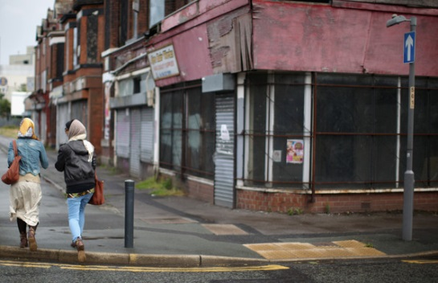
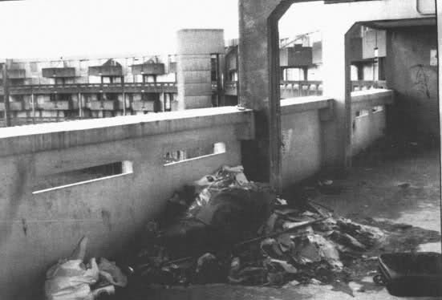
origins
Crime in social housing projects
Crime in public and semi-public spaces
Architectural modifications
Community self-protection
Defensible space
Mixed-use urban planning

Slide 3
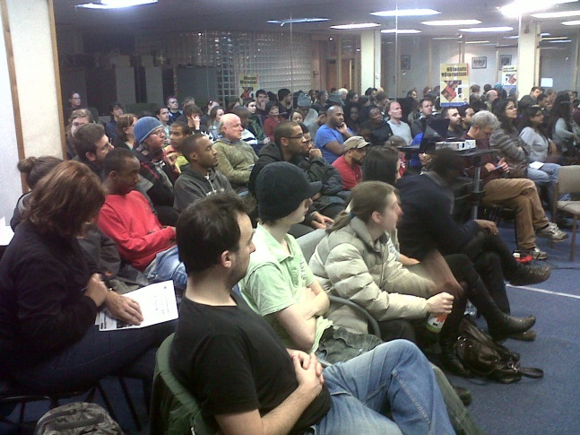
successes
Proved effective in social housing
Effective in buildings and spaces
Widely adopted by Police forces
Government supported
Extended to product design
Adopted in Planning & Urban Design
Adopted in community crime prevention

Slide 4
challenges
People do not defend in defensible space
Mixed-use and New Urbanist planning do not reduce crime
Access control, target hardening and security do not stop crime
Yet, CPTED appears to lower crime levels

Slide 5
New directions in CPTEd
Ethology – study of animal behaviors
Motivation and demotivation
Mapping of motivations, people, crime opportunities, precipitators
Dynamic modelling of crime causal situations (rather than hotspots)

Slide 6
Thank you
Dr. Terence Love
Director Design Out Crime Research Centre terry@designoutcrime.org Tel: 0434975848 www.designoutcrime.org

